Slide 1
WELCOME to
Analog Transmission of Digital Data Using FSK and FDM: Implications for Modern Communication Systems

Slide 2
AIMS AND OBJECTIVES
This experiment aims to convert digital signals into analog using FSK, combine them via FDM, and recover them through demultiplexing and demodulation. It demonstrates how multiple data streams can be transmitted over a shared medium while preserving signal integrity and separation in digital communication systems.

Slide 3
Impact on Society, Health, and Safety
Shift keying (FSK) and multiplexing (FDM) are key to modern communication.
Society: Improve internet and mobile connectivity.
Health: Support telemedicine and remote monitoring.
Safety: Enable emergency and transport data systems.
Culture: Allow global media and cultural exchange.

Slide 4
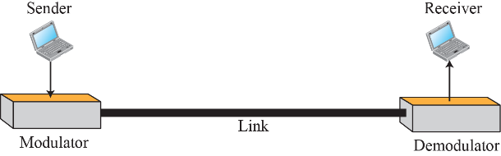
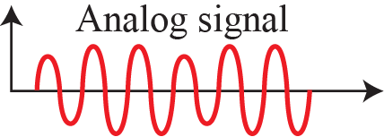
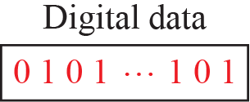
Digital to Analog Conversion

Slide 5
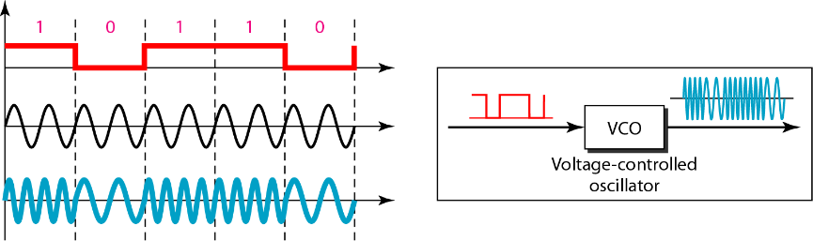

Implementation of BFSK
Binary Frequency Shift Keying (BFSK) is a type of digital modulation where two different frequencies represent binary 0 and 1.

Slide 6
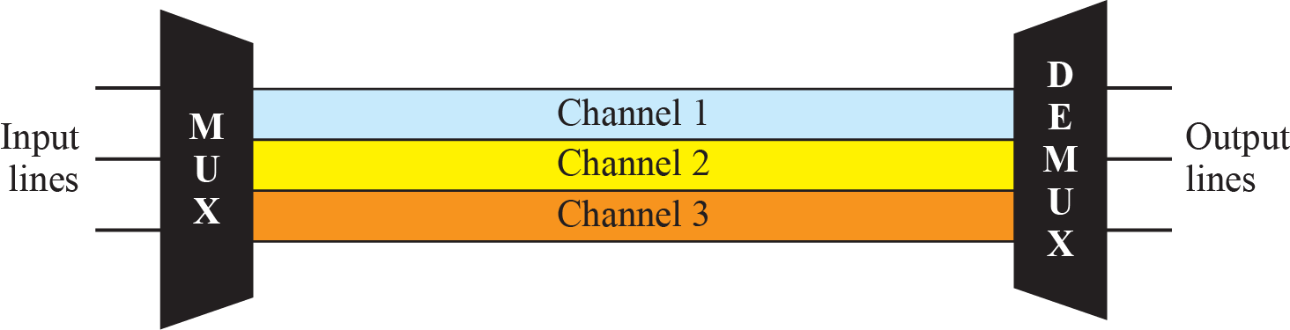
Frequency-Division Multiplexing

Slide 7
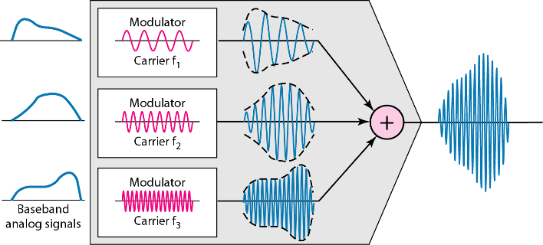
FDM Process

Slide 8
Procedure
Digital signals:
x1 = [1 0 1 1 0 0 1 0], x2 = [0 1 0 0 1 1 0 1]
Converted to unipolar NRZ with 1s bit duration
FSK modulation applied:
0 → 2 Hz, 1 → 5 Hz
x2’s FSK signal was shifted using a 20 Hz carrier for FDM
x1 and shifted x2 signals were added to form a composite signal.
Bandpass filters separated x1 and x2 based on their frequency bands
x2 was multiplied by 20 Hz carrier to return to baseband.
FFT identified dominant frequencies (2 Hz or 5 Hz) in each bit period.
x1 and x2 were reconstructed from detected frequencies
Plots verified each step: original signals, FSK, composite, and outputs.

Slide 9
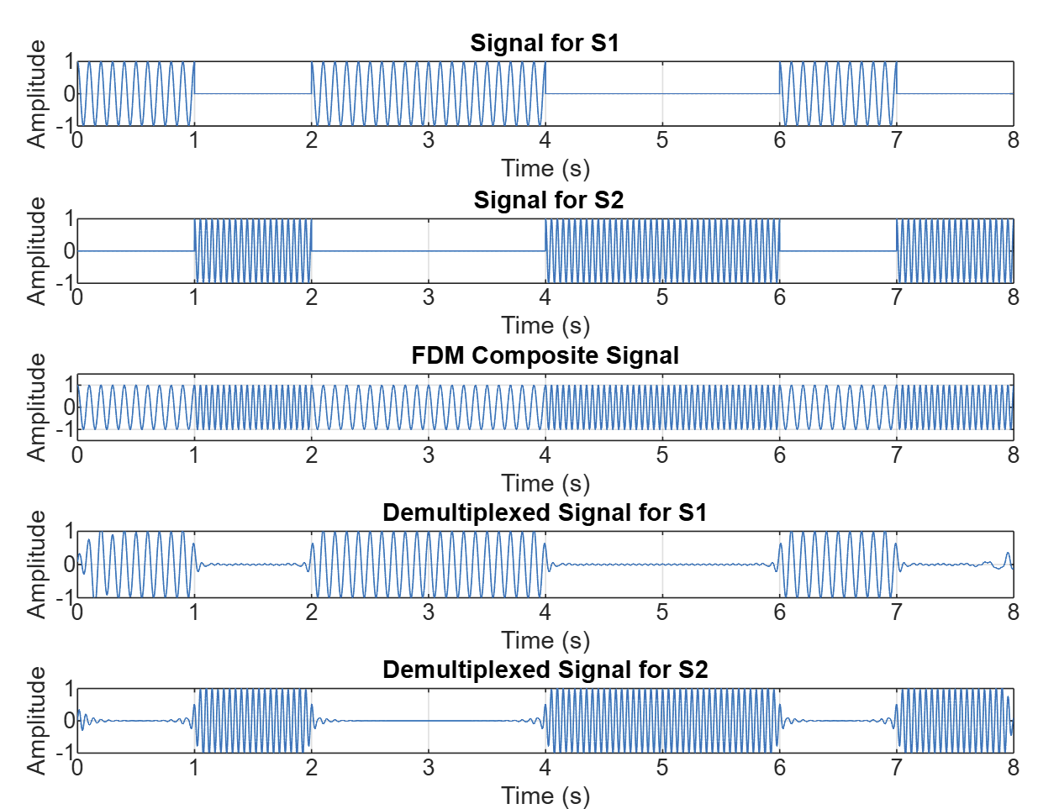
Matlab Output

Slide 10
Advantages of FSK (Frequency Shift Keying)
Noise Resistance: FSK is less affected by noise compared to amplitude-based modulation
Simple Demodulation: Easy to detect and demodulate using simple circuits
Reliable Data Transmission: Good for digital data over noisy channels.
Constant Amplitude Signal: Power remains constant, reducing distortion.
Widely Used: Common in modems, radio transmission, and telemetry.

Slide 11
Advantages of FDM (Frequency Division Multiplexing)
Simultaneous Transmission: Multiple signals can be sent at the same time
Efficient Bandwidth Use: Makes use of available bandwidth by dividing it into channels.
Low Latency: Continuous signal flow means minimal delay
Simple Demultiplexing: Each signal has its own frequency band, making separation easy.
Used in Analog Systems: Ideal for TV, radio, and telephone systems.

Slide 12
CONCLUSION
This experiment showed that we can send two digital signals at the same time using FSK and FDM. The signals were sent, combined, and then separated successfully. It worked like how real systems (like mobile networks and DSL) send data. One big advantage is that it saves bandwidth and allows many users to send data at once. This is useful for fast and efficient communication. But the system is a bit complex. It needs exact timing and filtering. We had to carefully choose the frequencies and adjust filters so the signals didn’t mix or get lost. Overall, it was a good learning experience.

Slide 13

Thank you

Slide 14
QUESTION
ANSWER PART
“

